Slide 1



Infection Prevention and Control of novel coronavirus (COVID-19): standard precautions and use of Chrono-Bus
Akshat Khanna
Nitesh Nijhawan

Slide 2
Infection Prevention and Control of COVID-19
Limit human-to-human transmission
Reduce secondary infections
Prevent transmission through amplification and super-spreading events

Slide 3
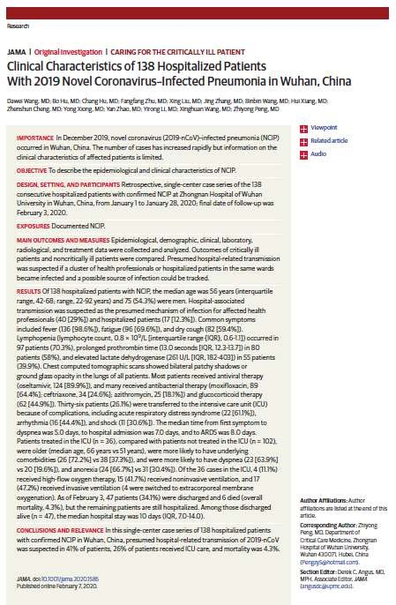

Healthcare workers and COVID-19
N = 138 confirmed cases COVID-19 on a healthcare facility
N = 81 confirmed case, COVID-19, community
N = 17 confirmed case, COVID-19, during hospital stay N = 40 confirmed case, COVID-19, healthcare worker

Slide 4
Standard precautions
“(…) A set of practices that are applied to the care of patients, regardless of the state of infection (suspicion or confirmation), in any place where health services are provided. (…)”

Slide 5

Some questions to consider . . .
Does the patient fulfill case definition criteria for the disease?
What is the infectious agent and its mode of transmission?
What type of procedure will the patient be undergoing?
Is there any risk of contamination?
Where should the patient be located?
What type of PPE will need to be used?

Slide 6
In summary,
The use of personal protective equipment (PPE) by healthcare workers requires an evaluation of the risk related to healthcare-related activities;
The following precautions are recommended for the care of patients with suspected or confirmed cases of COVID-19:
For any suspected or confirmed cases of COVID-19
standard + contact + droplet precautions
For any suspected or confirmed cases of COVID-19 and AGP
standard + contact + airborne precautions
as of February 19, 2020 – subject to change as new evidence become available

Slide 7
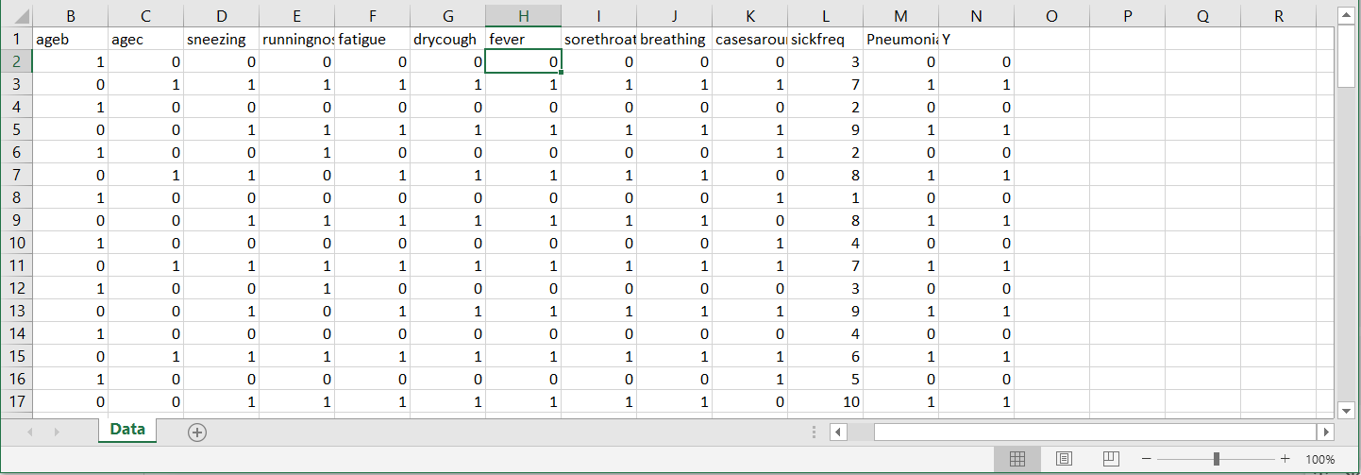
Data

Slide 8
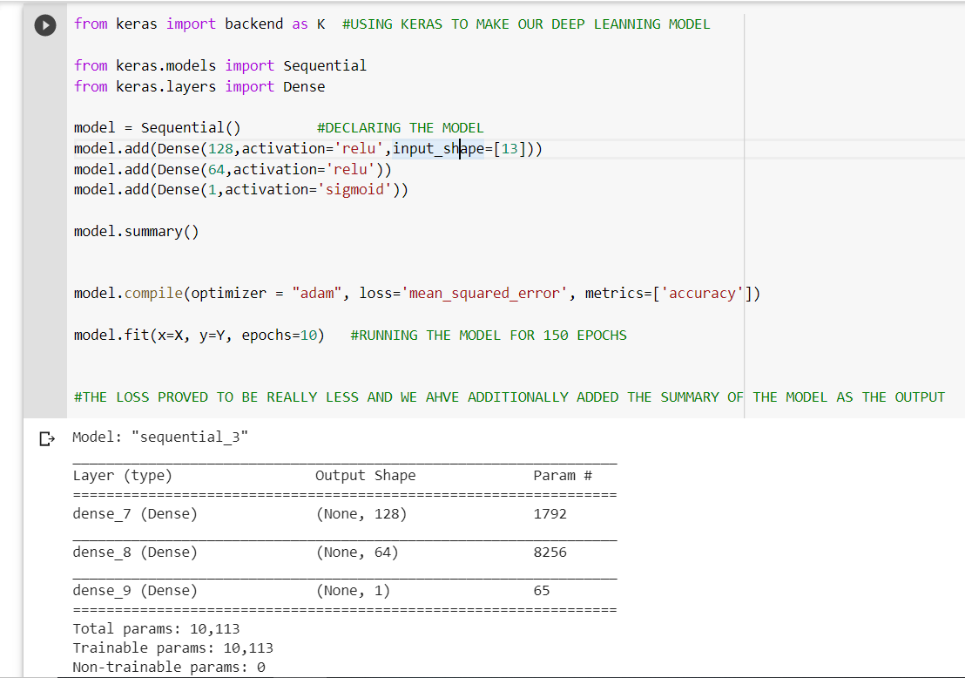
Deep Learning Model

Slide 9
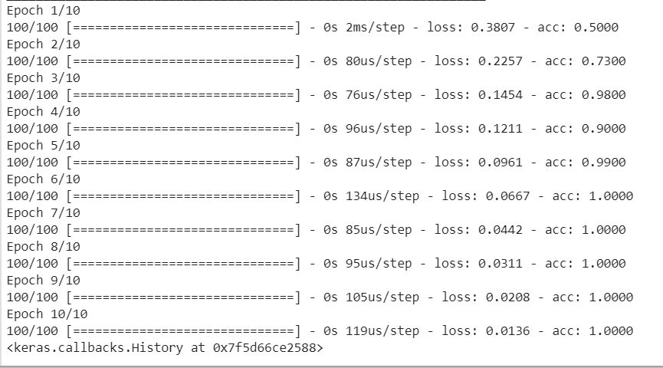
Accuracy of Model

Slide 10
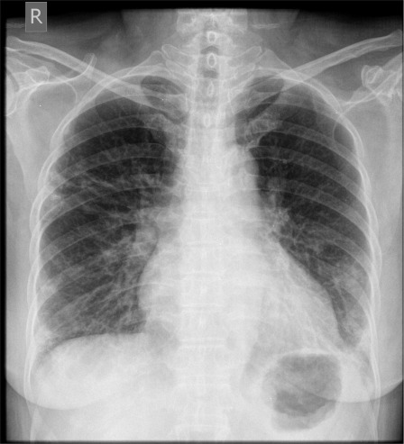
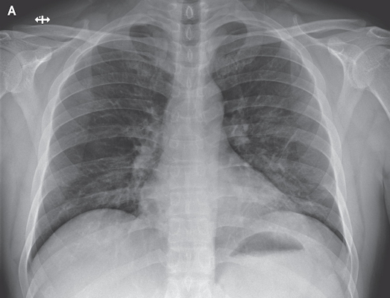
The ultimate Feature

Slide 11
Conclusion
This can be deployed by Govt. Sectors to know about the people getting affected.
It can be used to analyze the spread of virus
It can be linked with Aadhar Data
An individual can do a health check at home
Online Registration of patients suffering from Corona Virus

